Slide 1
2019 MMILAB.DIP Seminar Week3(1/16~1/22)
20151415 김성수

Slide 2
Contents
Thresholding
- Global Thresholding (Basic, Otsu)
- Improvement (Smoothing, Using Edges)
- Multiple Threshold
- Image Partitioning
- Variable Thresholding(Local image properties)
- Moving Average Thresholding
Morphological image processing
- Erosion, Dilation, Opening, Closing
- Boundary Extraction

Slide 3
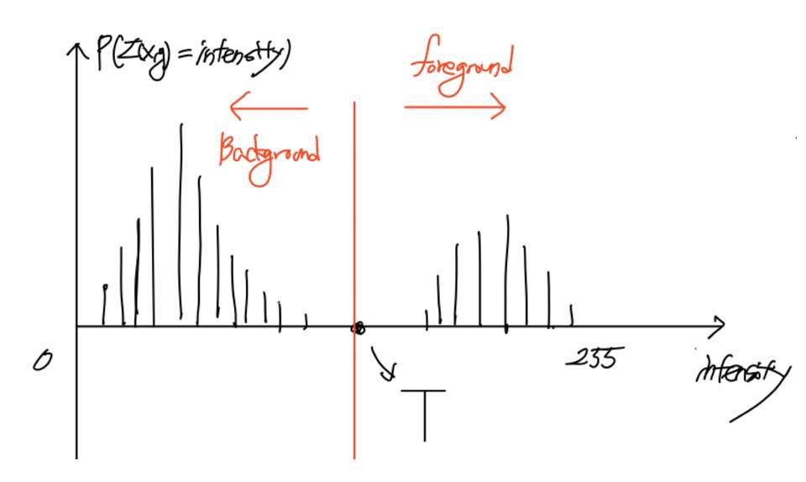

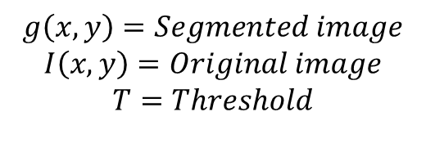
Thresholding
Thresholding : Image segmentation→ Seperating background and foreground
Histogram of image
How to choose T?
1. Try to choose T that works for entire image
(global threshold)
2. Choose local threshold
Noise can change
foreground and background of image
$$g\left(x,y\right)= \left\{\begin{aligned}1 if I\left(x,y\right)>T \\ 0 if I\left(x,y\right)≤T\end{aligned}\right.$$
$$g\left(x,y\right)=Segmented image$$
$$I\left(x,y\right)=Original image$$
$$T=Threshold$$

Slide 4
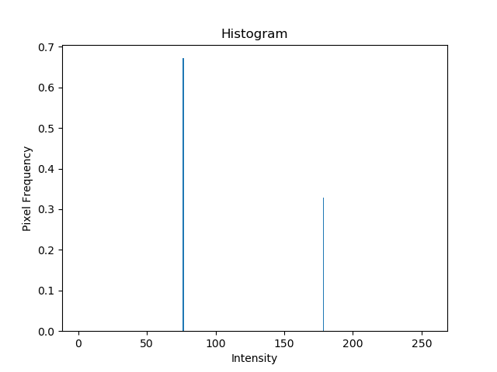
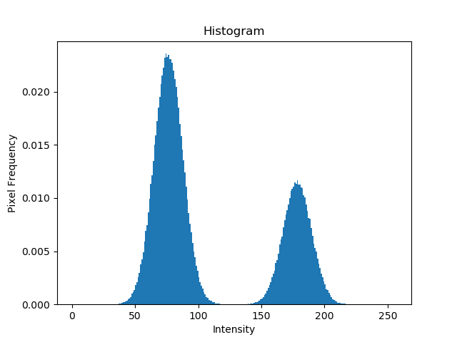
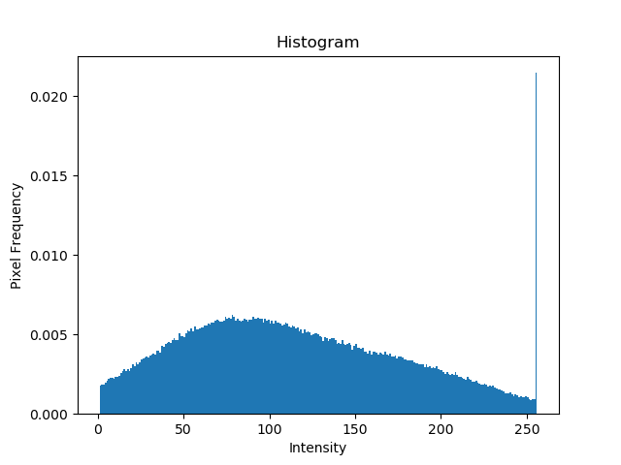
Effect of noise
Original
Mean = 0, Std = 10
Gaussian noise
Mean = 0, Std = 50
Gaussian noise

Slide 5
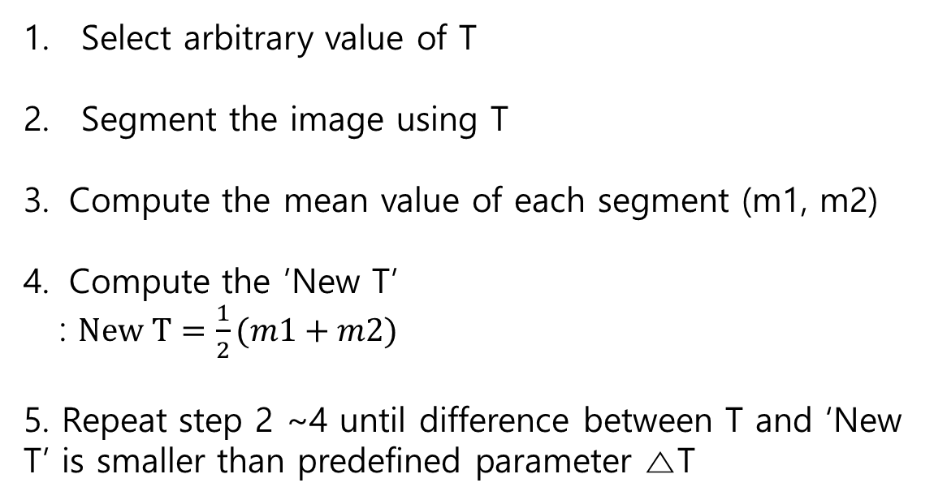
Basic Global Thresholding
Select arbitrary value of T
Segment the image using T
Compute the mean value of each segment (m1, m2)
Compute the ’New T’
: $New T=\frac{1}{2}(m1+m2)$
5. Repeat step 2 ~4 until difference between T and ‘New T’ is smaller than predefined parameter △T

Slide 6
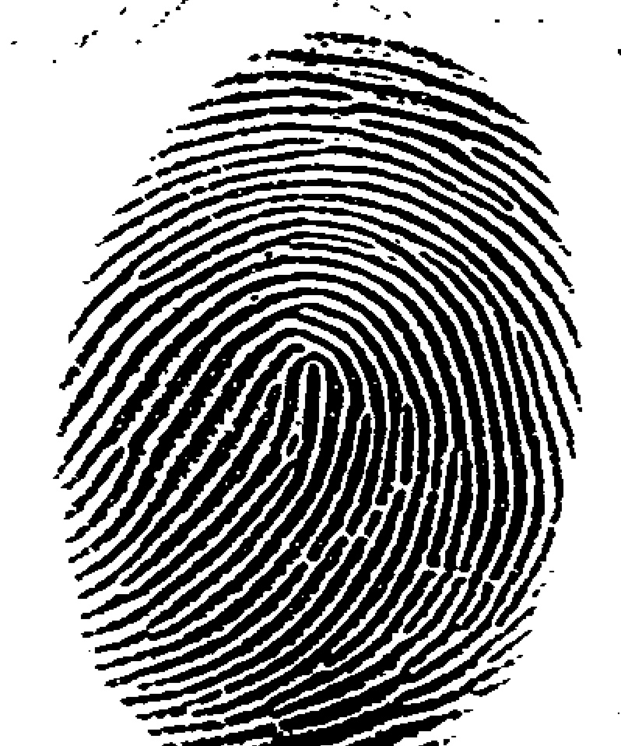
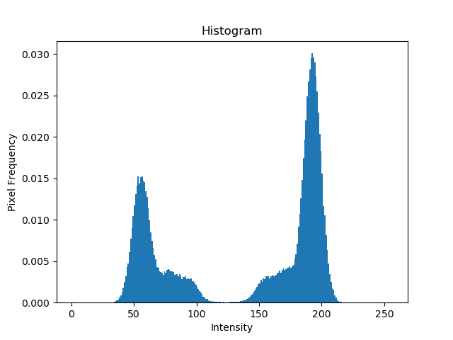
Basic Global Thresholding
Initial T = mean of entire image intensity, △T=0
Original
Histogram
T= 125.38

Slide 7
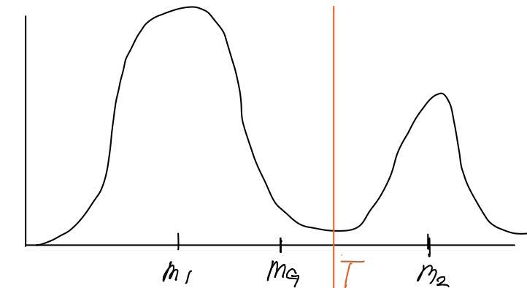
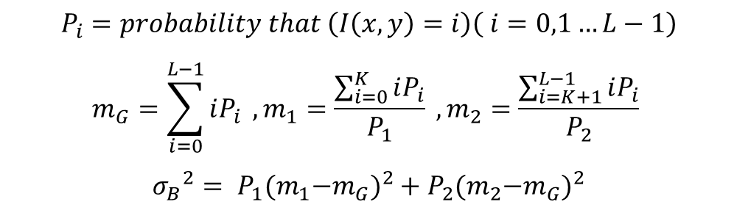
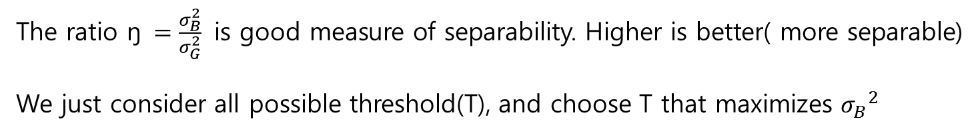
Otsu Algorithm
Class 1
Class 2
Idea : Maximize the between-class variance ${σ_{B}}_{ }^{2}$
Probability
$$P_{i}=probability that \left(I\left(x,y\right)=i\right)\left( i=0,1…L−1\right)$$
$$m_{G}=\sum_{i=0}^{L−1}{iP_{i}} ,m_{1}=\frac{\sum_{i=0}^{K}{iP_{i}}}{P_{1}} ,m_{2}=\frac{\sum_{i=K+1}^{L−1}{iP_{i}}}{P_{2}}$$
$${σ_{B}}_{ }^{2}= P_{1}{{(m}_{1}−m_{G})}^{2}+P_{2}{{(m}_{2}−m_{G})}^{2}$$
Intensity
The ratio ŋ $=\frac{σ_{B}^{2}}{σ_{G}^{2}}$ is good measure of separability. Higher is better( more separable)
We just consider all possible threshold(T), and choose T that maximizes ${σ_{B}}_{ }^{2}$

Slide 8
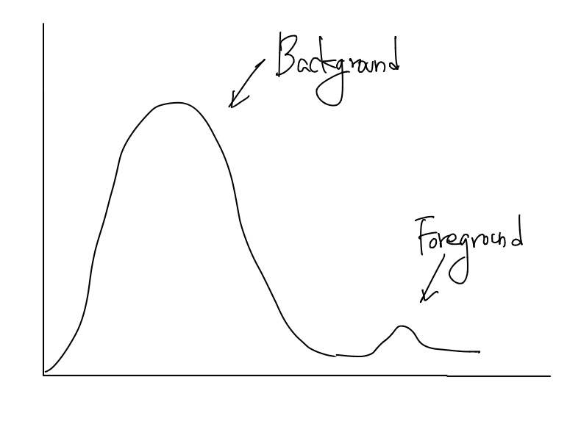
Otsu Algorithm
Otsu can fail when :
There is no strong peaks in histogram
Object is too small with respect to background
Remedies:
Apply low-pass filter to image, then apply otsu algorithm
Only consider pixels near edges when computing the threshold

Slide 9


Otsu Thresholding
Original
Basic global thresholding
T= 169.4
Otsu’s method
T = 182

Slide 10
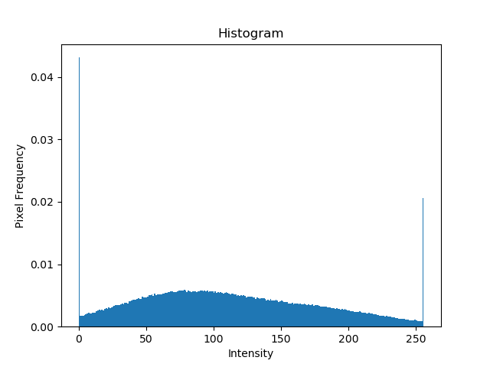

Improvement – Using Smoothing
Gaussian noise image
Histogram
Otsu (T_opt = 119, Sep= 0.69)

Slide 11
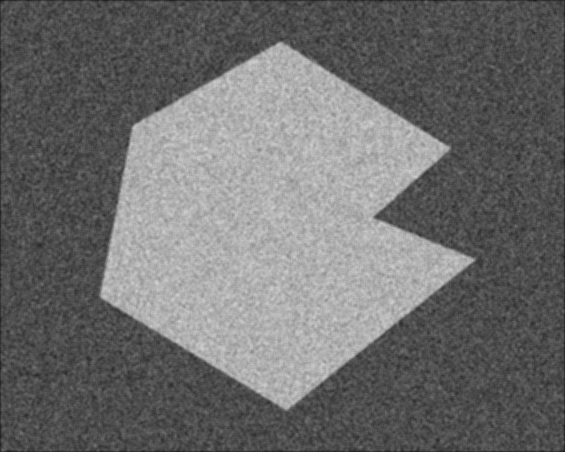
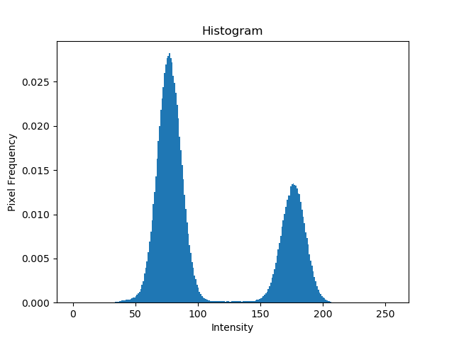

Improvement – Using Smoothing
5 X 5 smoothing image
Histogram
Otsu (T_opt = 127, Sep= 0.95)

Slide 12
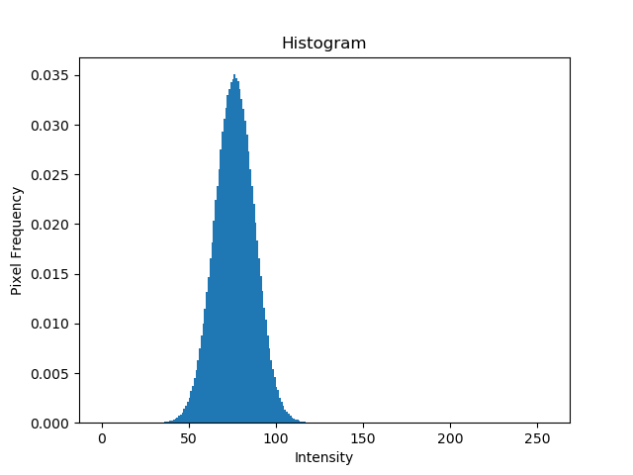
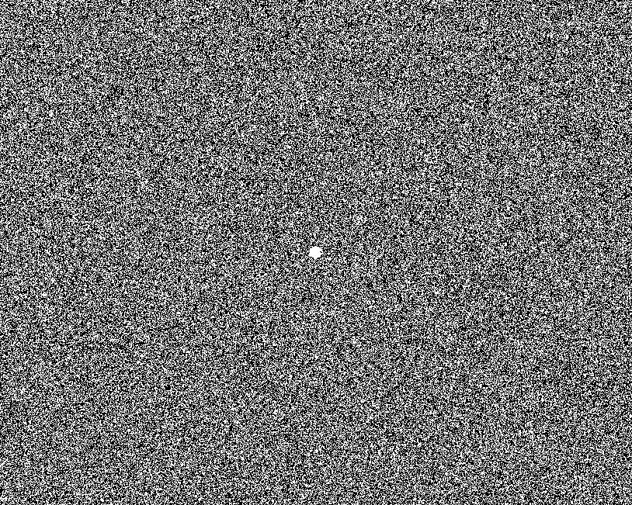
Improvement – Using Smoothing
Original
Histogram
Otsu (T_opt = 77, Sep= 0.62)

Slide 13
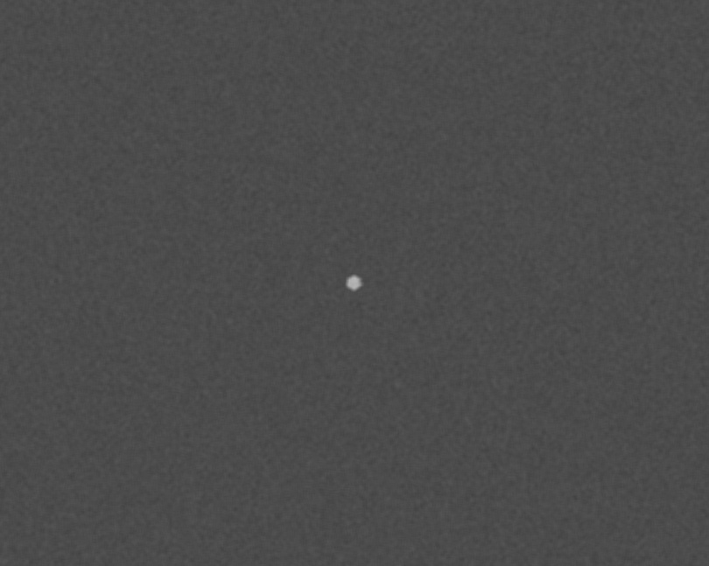
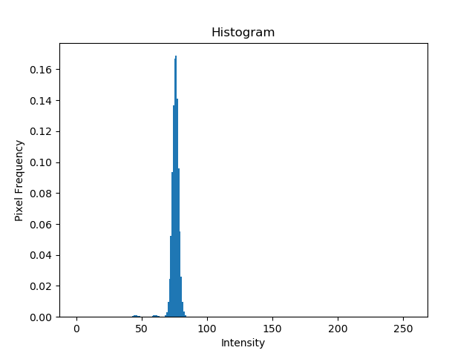
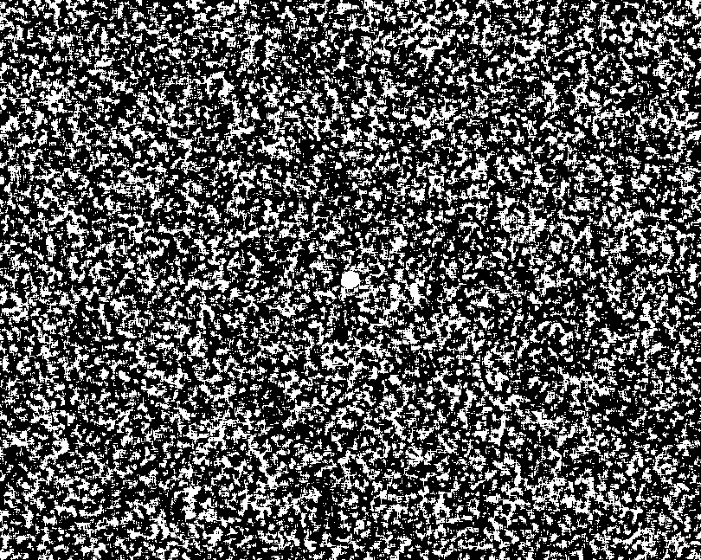
Improvement – Using Smoothing
5 X 5 smoothing image
Histogram
Otsu (T_opt = 76, Sep= 0.42)

Slide 14
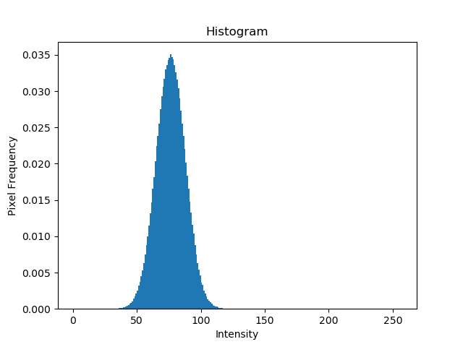
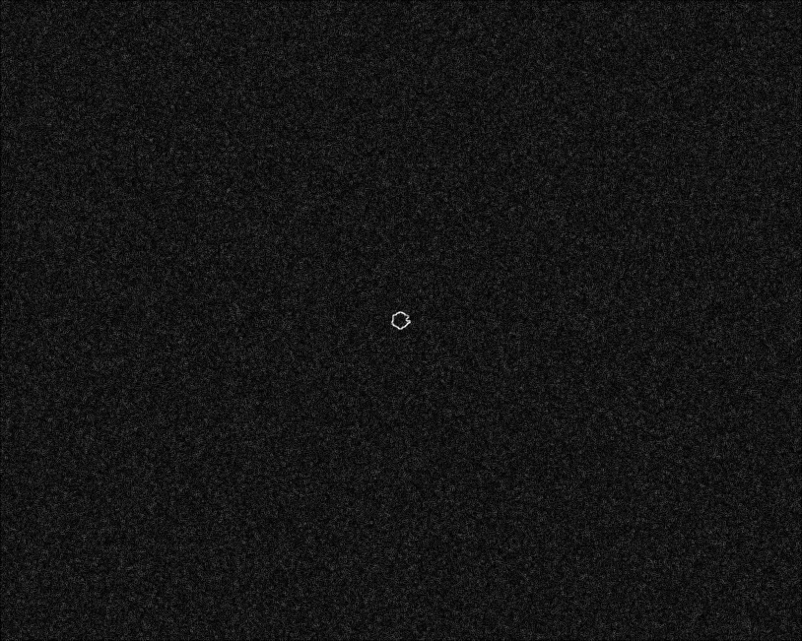
Improvement – Using Edges(Sobel)
Original
Histogram
Sobel (edge image)

Slide 15
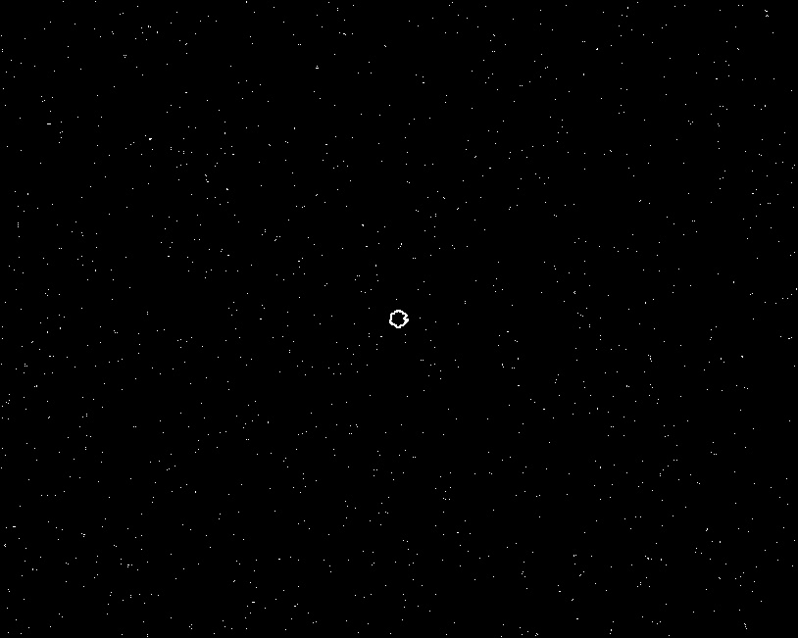
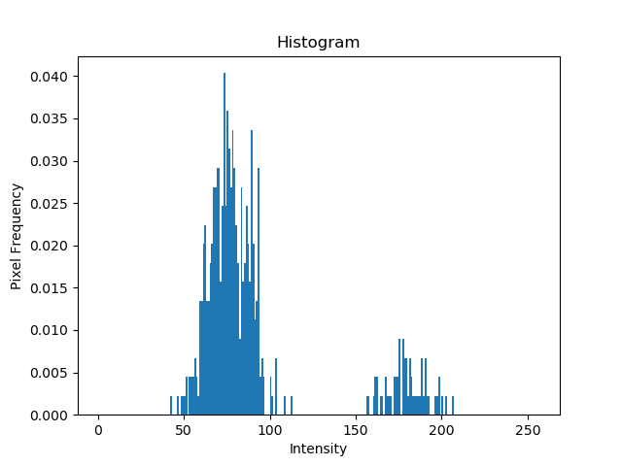

Improvement – Using Edges(Sobel)
Sobel (percentile 99.7 image)
Histogram
Otsu (T_opt = 129, Sep= 0.42)

Slide 16
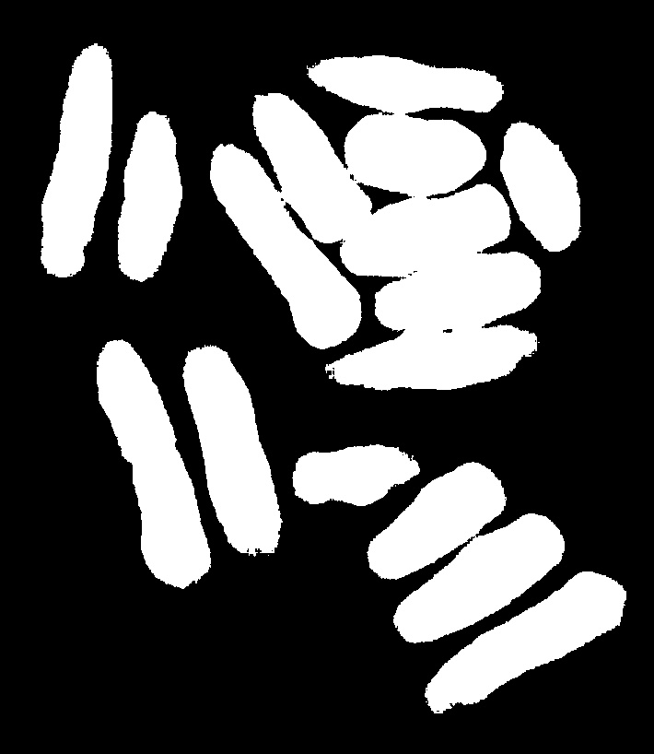
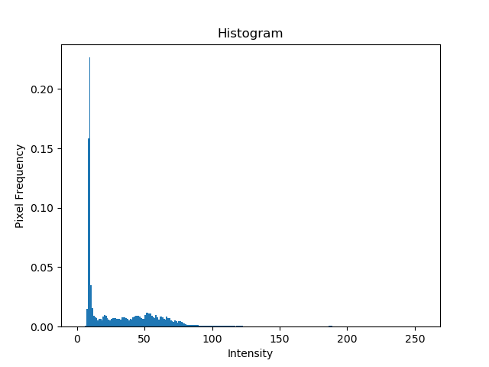
Improvement – Using Edges(Laplacian)
Original
Histogram
Otsu thresholding
( T=43, Sep =0.636)

Slide 17
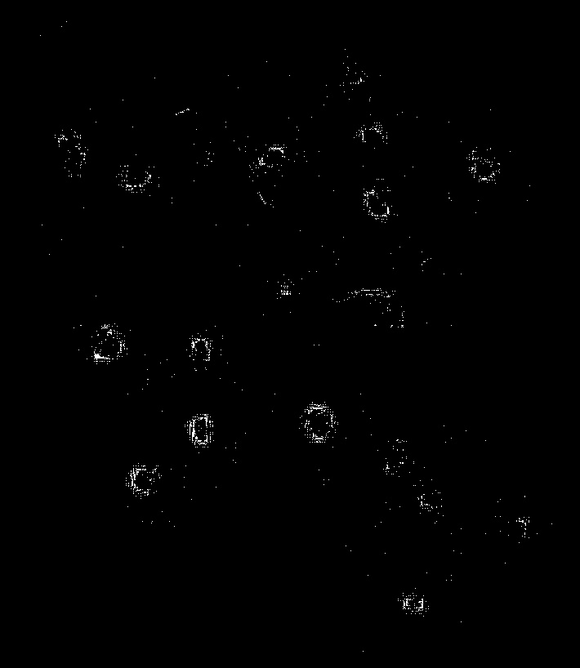
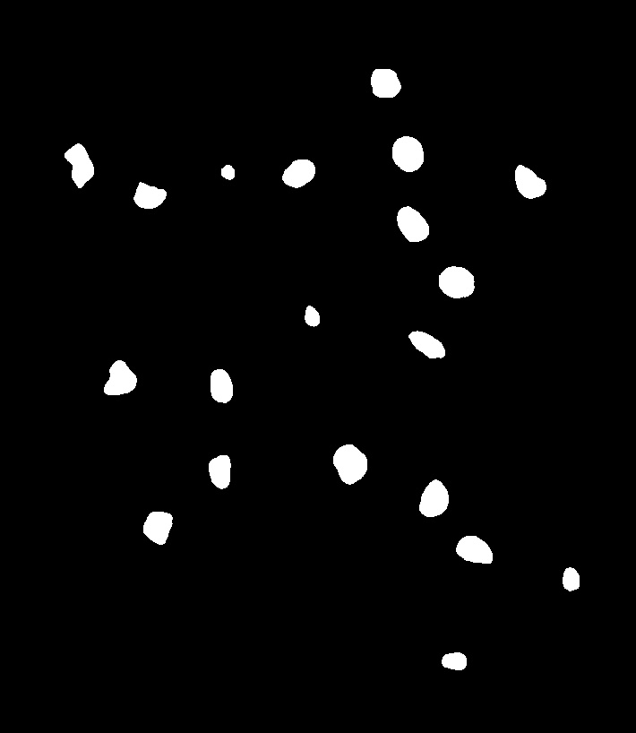
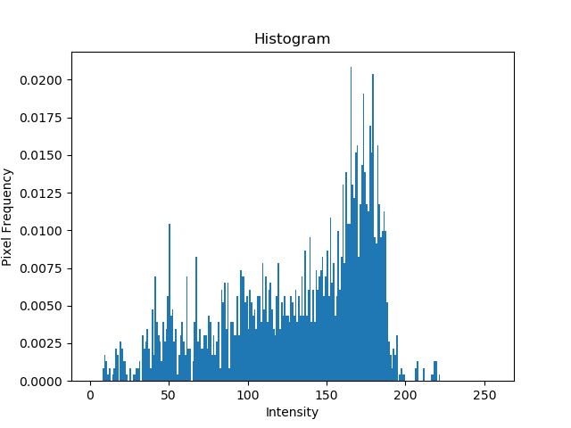
Improvement – Using Edges(Laplacian)
Laplacian
Histogram
Otsu thresholding
( T=115, Sep =0.76)

Slide 18
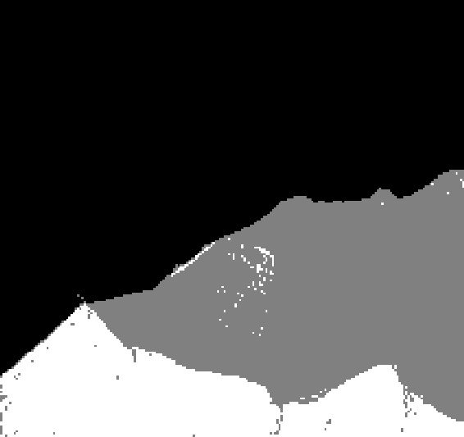
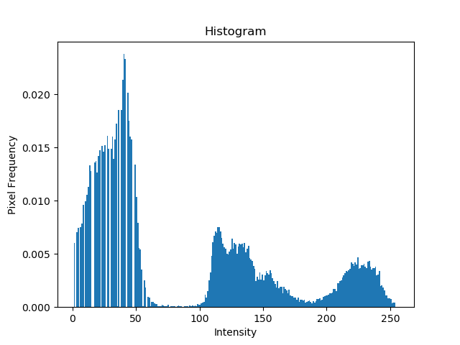
Multiple Thresholding
Original
Histogram
Multiple thresholding

Slide 19
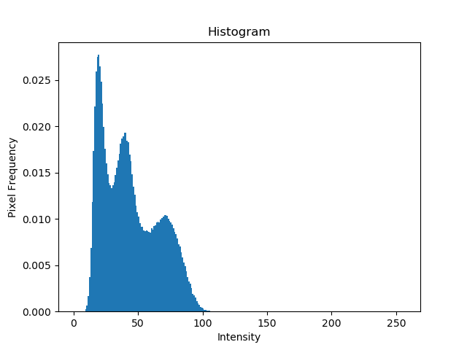
Image Partitioning
Original (Noisy shade)
Histogram

Slide 20
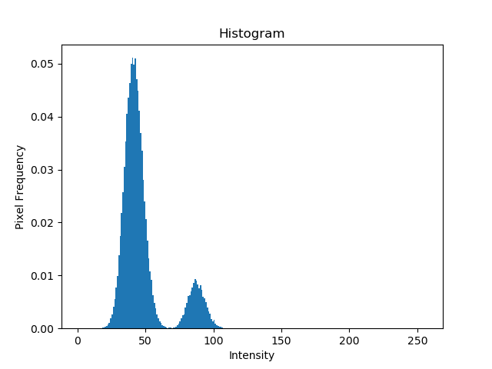
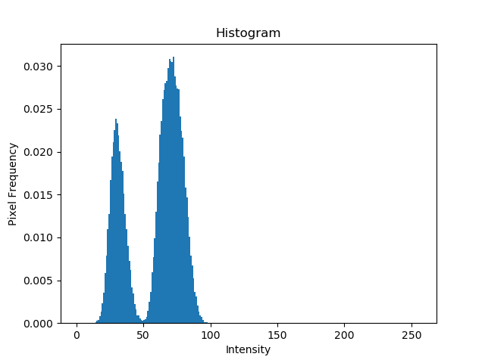
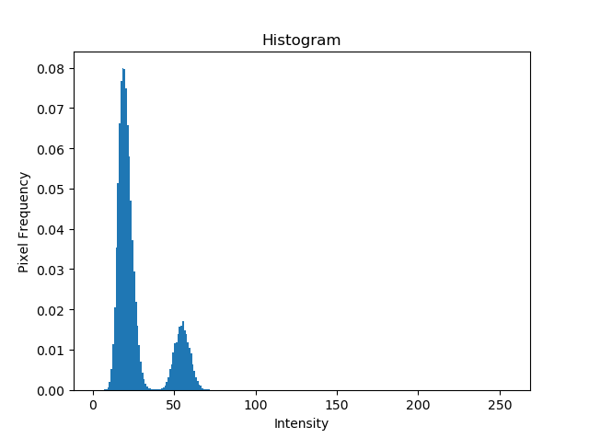
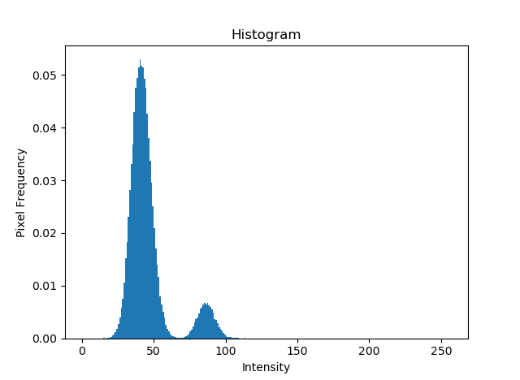

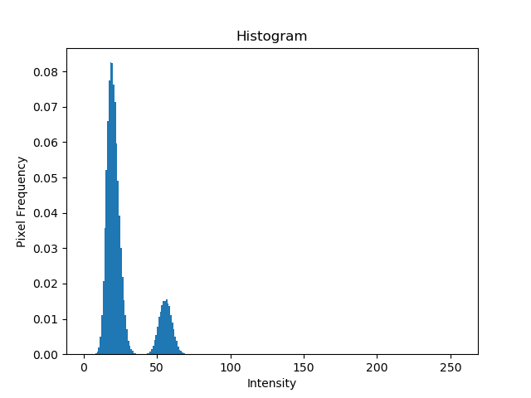
Image Partitioning
T_opt = 40
T_opt = 51
T_opt = 64
T_opt = 38
T_opt = 51
T_opt = 65

Slide 21



Image Partitioning
Basic Global Thresholding
T= 48.8
Otsu Thresholding
T_opt = 50
Partitioned Thresholding

Slide 22
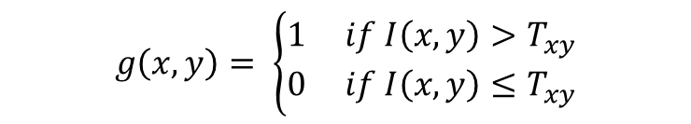
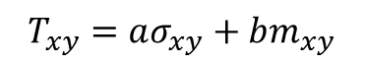
Variable Thresholding(Local properties)
I(x-1,y-1) | I(x,y-1) | I(x+1,y-1)
I(x-1,y) | I(x,y) | I(x+1,y)
I(x-1,y+1) | I(x,y+1) | I(x+1,y+1)
$T_{xy}=aσ_{xy}+bm_{xy}$
$$g\left(x,y\right)= \left\{\begin{aligned}1 if I\left(x,y\right)>T_{xy} \\ 0 if I\left(x,y\right)≤T_{xy}\end{aligned}\right.$$

Slide 23

Variable Thresholding(Local properties)
Original
Multiple Thresholding

Slide 24
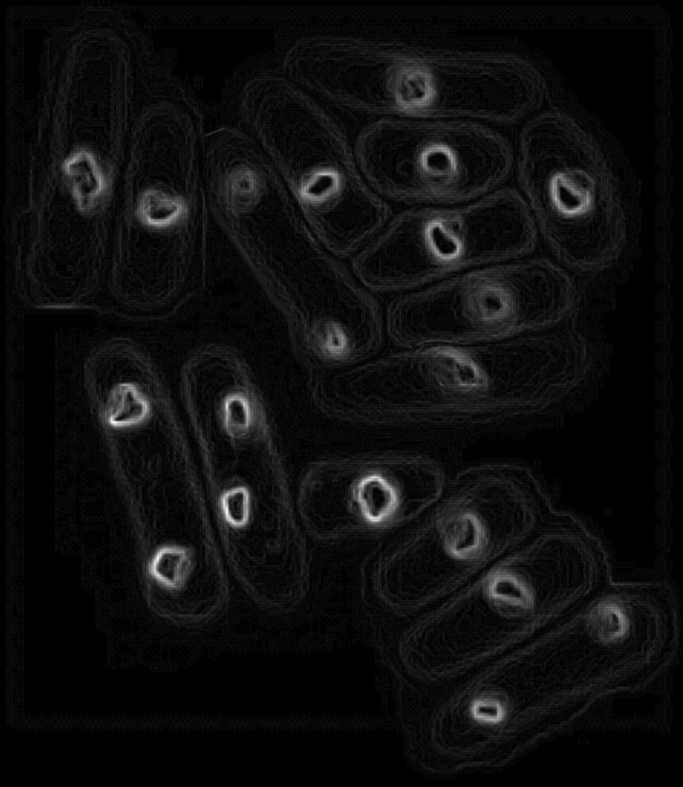
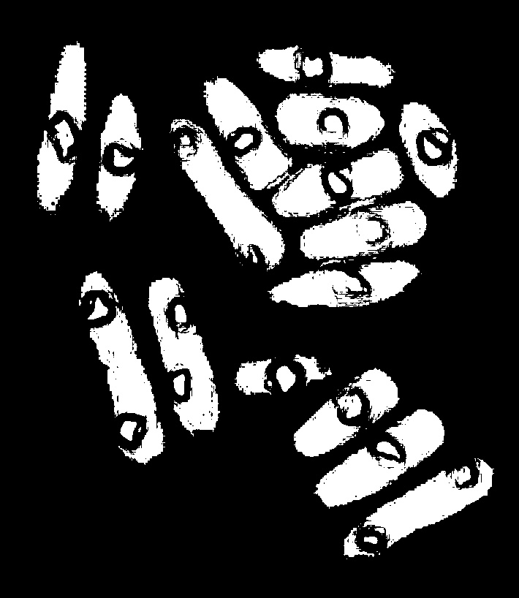
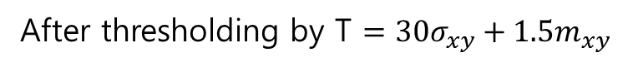
Variable Thresholding(Local properties)
Local variance image (after scaling)
After thresholding by T $=30σ_{xy}+1.5m_{xy}$

Slide 25
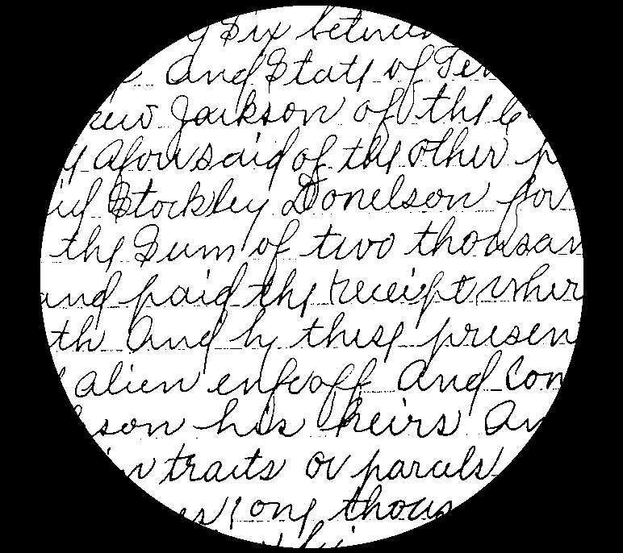
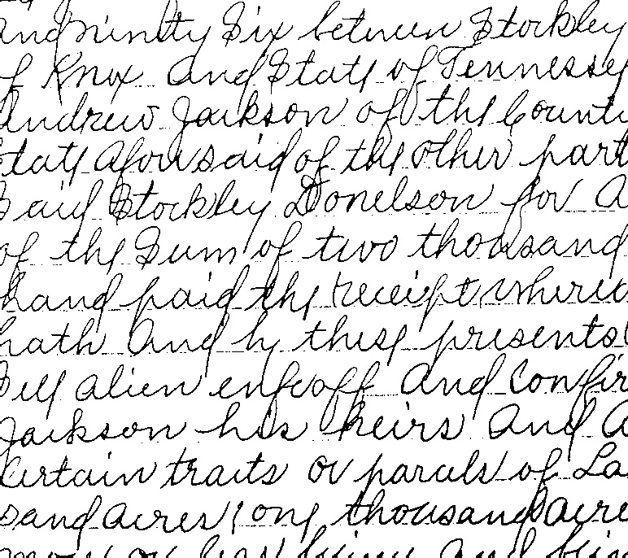
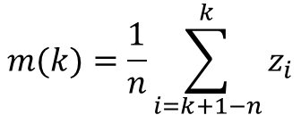
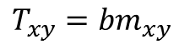
Moving average Thresholding
Original
Otsu
Moving Average Thresholding
n = 20 ,b=0.5
$$m(k)=\frac{1}{n}\sum_{i=k+1−n}^{k}{z_{i}}$$
$$T_{xy}={bm}_{xy}$$

Slide 26

Moving average Thresholding
Original
Otsu

Slide 27





Moving average Thresholding
n=20
b=0.5
b=0.3
b=0.1
n=30

Slide 28
Morphological image processing
※Operate on a Binary image (After thresholding)
False negative
False positive
False positive
cause 2 objects to appear as 1

Slide 29
Morphological image processing
Structuring element :
A small pixel template that helps to produce new image
0 | 1 | 0
1 | 1 | 1
0 | 1 | 0
1 | 1 | 1
1 | 1 | 1
1 | 1 | 1
1
1
1
. . . .
Disk
Square

Slide 30
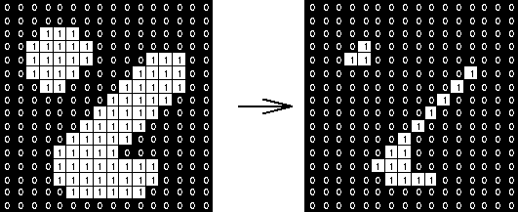
Erosion
1 | 1 | 1
1 | 1 | 1
1 | 1 | 1
3 X 3 square structure
Original
After Erosion

Slide 31

Erosion
Original
3 X 3 Square Erosion

Slide 32



Erosion
5 X 5 Square Erosion
11 X 11 Square Erosion
15 X 15 Square Erosion
45 X 45 Square Erosion

Slide 33
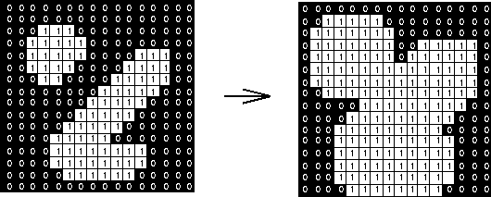
Dilation
1 | 1 | 1
1 | 1 | 1
1 | 1 | 1
3 X 3 square structure

Slide 34

Dilation
Original

Slide 35
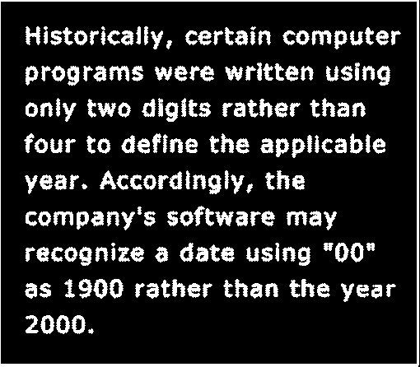

Dilation
3 X 3 Disk dilation

Slide 36
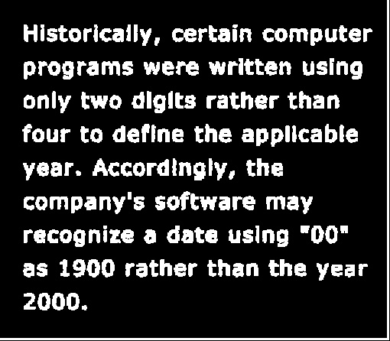

Dilation
3 X 3 Square dilation

Slide 37

Opening and Closing
A : Original Image
B : Structure element
Erosion
Dilation after Erosion
Opening
Dilation
Erosion after Dilation
Closing

Slide 38


Opening (3x3 square)
Original
Erosion
Opening(Dilation after Erosion)

Slide 39


Closing (3x3 square)
Opening
Dilation
Closing (Erosion after Dilation)

Slide 40
Opening and Closing
Original
After Opening and Closing

Slide 41


Boundary Extraction
Original
Erosion
Boundary Extraction

Slide 42
THANK YOU for your attention

